Slide 1
Do Events hosted by Phone Companies impact their stock values?
Ruchiraprakan Pamonpon(21229058)
Jason Sebastian (21224520)

Slide 2
Introduction
As phones got gradually more popular since the release of Iphone. People started getting used to smartphone as another part of their activity. Recent technology is proceeding in a much faster time than the 90s and there is a hype over a new phone release yearly from various phones company. We want to know how new features, consumer expectations, and market trends influence investor behavior and stock performance.

Slide 3
AlphaVantage API
https://www.alphavantage.co/
AlphaVantage is a well-known API providing historical and real-time market data on stocks, foreign exchange (FX), cryptocurrencies, and other financial assets. Developers, analysts, and traders use it extensively to do algorithmic trading, automate trading systems, conduct market research, and incorporate financial data into their applications.

Slide 4
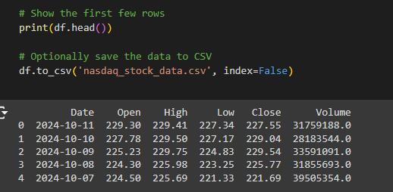
Example output from Alphavantage API

Slide 5
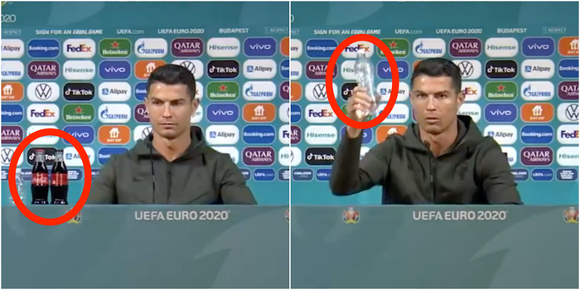
As the Portugal captain sat down to chat with the media in Budapest on Monday before of his country's Group F opener against Hungary, he was clearly concerned to see two bottles of the fizzy soft drink in front of him.
With Ronaldo's activities, Coca-Cola's share price dropped by 1.6% to $55.22. Market value decreased by $4 billion, from $242 billion to $238 billion.(Garcia, 2021)

Slide 6
Hypothesis 1: Every time Apple does a phone launch, their stock value rises
Null Hypothesis: Apple launch events do not affect their stock value.

Slide 7
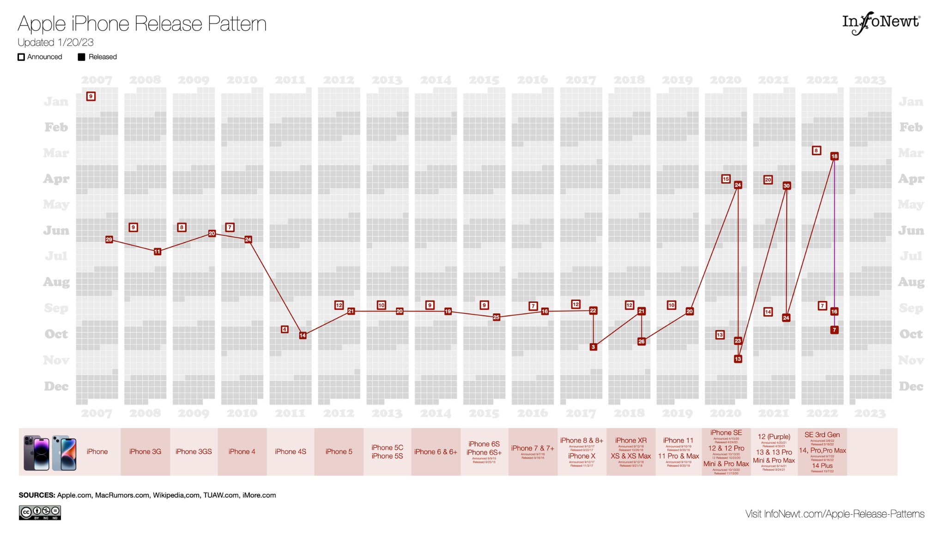
Apple’s Launch Dates
https://infonewt.com/apple-release-patterns

Slide 8
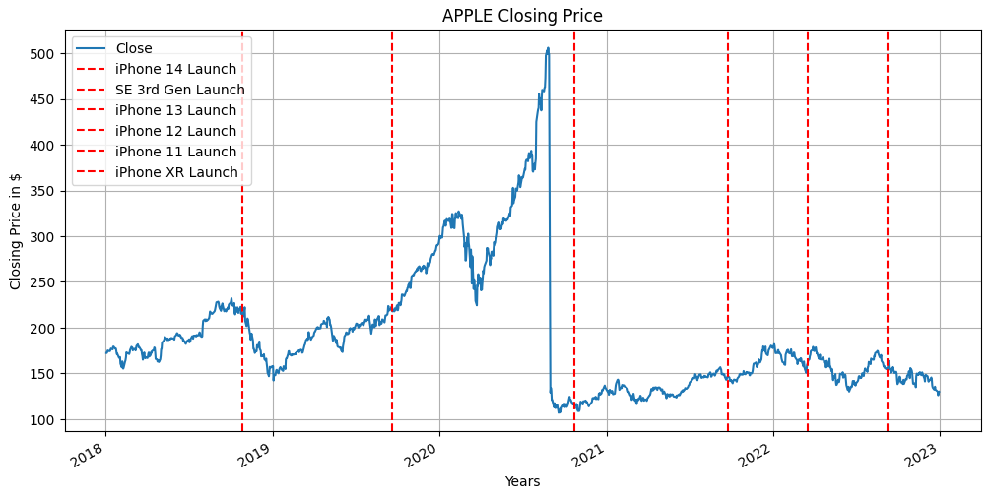
Visual 1:

Slide 9
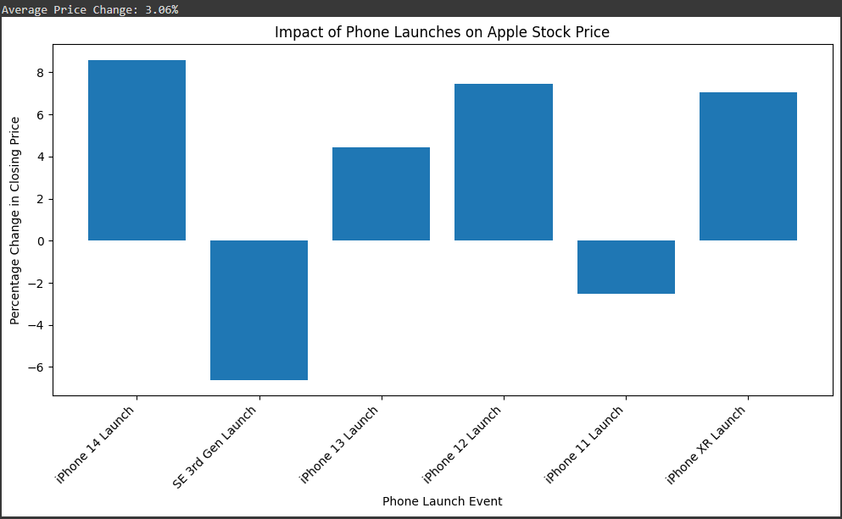
Visual 2:

Slide 10
Explanation
Apple Launch Events do not increase its stock value.
They tend to show a slight increase, but none too significant to prove it is because of the event.
Research has been made that User Generated Content (UGC) has affected the expectations of the launches and can affect the stock prices (van Dieijen et al., 2020).

Slide 11
Hypothesis 2: Samsung’s launch events also show an increase in stock value
Null Hypothesis: Samsung’s launch events do not affect their stock value
https://colab.research.google.com/drive/1gHL4sI7HpGu30-xiqAgSdsdDHN4j3yBG?usp=sharing

Slide 12
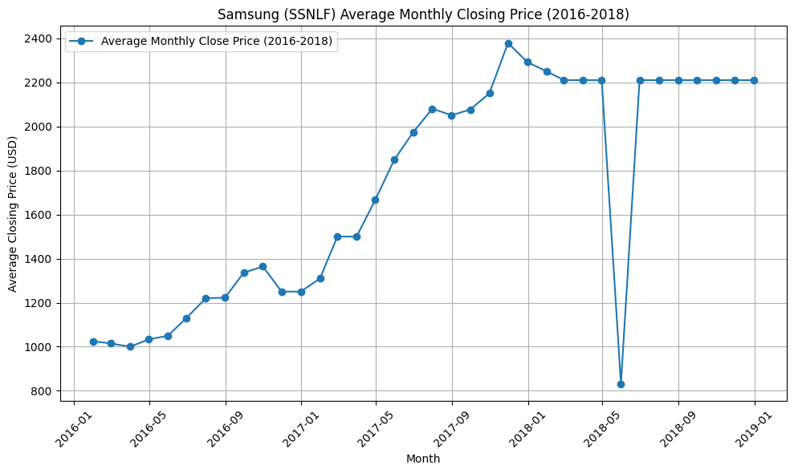
Problem on using AlphaVantage API (Late 2018 stock price)

Slide 13
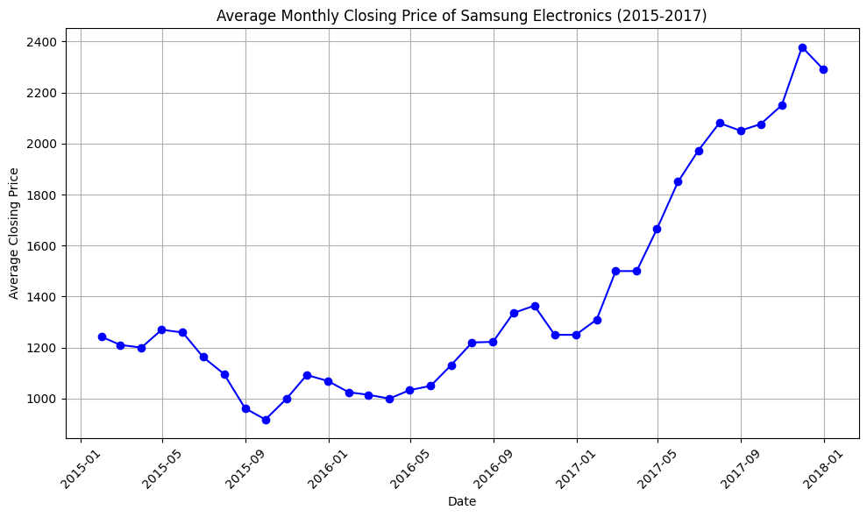
Visual 1: Average stock closing price of samsung by month

Slide 14
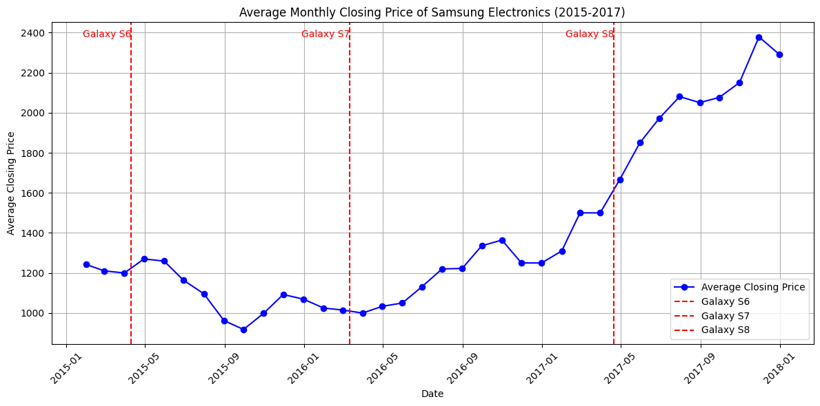
Visual 2: Average stock closing price of samsung by month including Samsung Galaxy S release date within the time frame

Slide 15
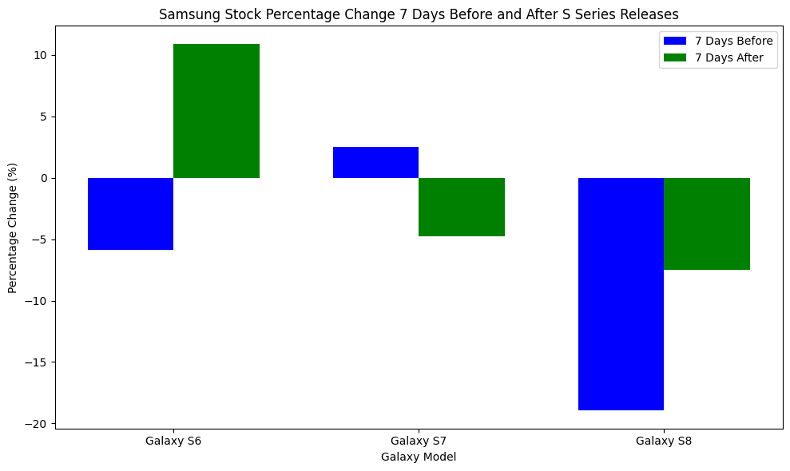
Samsung stock price trend before and after Phone release

Slide 16
Statistics for Galaxy S6 Release (Date: 2015-04-10):
Before Release (7 days):
Mean = 1207.14, Std = 22.28, Min = 1200.00, Max = 1275.00
After Release (7 days):
Mean = 1247.09, Std = 57.16, Min = 1150.00, Max = 1286.85
Statistics for Galaxy S7 Release (Date: 2016-03-11):
Before Release (7 days):
Mean = 1015.48, Std = 12.29, Min = 1000.00, Max = 1025.00
After Release (7 days):
Mean = 1025.61, Std = 25.30, Min = 1000.00, Max = 1050.00

Slide 17
Results
T-statistic: -1.2196288330976426, P-value: 0.3469131822463817
Fail to reject the null hypothesis: No significant increase in stock prices after the release.

Slide 18
Explanation
When the Galaxy S8 was introduced in March, Samsung noticed a minor gain in stock prices as investors put their trust in the likelihood that buyers will upgrade their existing Samsung phone.
With the release of the Galaxy Note 8, Samsung's second announcement of the year, profits and losses were distributed across cellular carriers and merchants, indicating that Wall Street was uninterested in the bigger, more potent Samsung smartphone.
Apple was one of the few exceptions, with its shares rising by 0.5 percent on the debut of the Galaxy Note 8 (Gonzalez, 2017).

Slide 19
Conclusion
The phone company’s launch events do not result in an increase in stock value.
External factors can be the reason why it fluctuates during the launch events.
Competition does not

Slide 20
Reference
Gonzalez, O. (2017, October 27). The iphone effect: How every new smartphone affects the stock market. NBCNews.com. https://www.nbcnews.com/tech/tech-news/iphone-effect-how-every-new-smartphone-affects-stock-market-n815021
van Dieijen, M., Borah, A., Tellis, G. J., & Franses, P. H. (2020). Big Data Analysis of volatility spillovers of brands across social media and stock markets. Industrial Marketing Management, 88, 465–484. https://doi.org/10.1016/j.indmarman.2018.12.006
Garcia, A. (2021, June 16). Cristiano Ronaldo snub sees Coca-Cola market value fall by $4bn - ESPN. ESPN.com. https://www.espn.com/soccer/story/_/id/37618171/cristiano-ronaldo-snub-sees-coca-cola-share-price-fall-4bn

